Slide 1
UROP update Feb 18
Credibility analysis in health communities
Nguyen Van Hoang

Slide 2
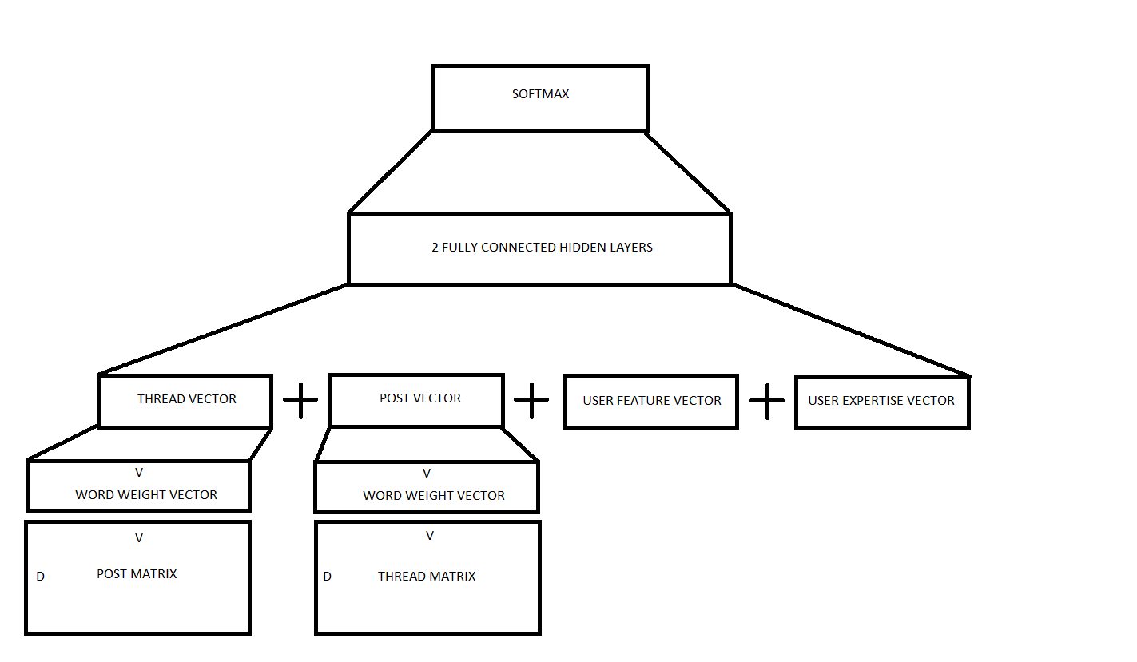
Apply feed forward neural network

Slide 3
Updated results
 | Proposed method | MLP | Hybrid
Area under the curve | 0.8173
Accuracy | 75.08 | 78.08 | 83.01
Recall | 74.59 | 66.42 | 70.23
Precision | 77.62 | 89.68 | 91.41
F1 score | 76.08 | 76.32 | 80.82

Slide 4
Problems with similarity annotation of credibility
1) The method cannot differentiate between causes and effects of drugs

Slide 5
Problems with similarity annotation of credibility
2) The method does not account for ambiguity in meaning
FALL
FALL IN LOVE
FALL ASLEEP
FALL (PHYSICALLY)

Slide 6
Problems with similarity annotation of credibility
3) The method does not account for ordering
WEIGHT GAIN
HAIR LOSS
WEIGHT LOSS
HAIR GAIN

Slide 7
Related works on truth discovery
Yaliang Li (2016) formally defines the truth discovery task as
“For a set of objects that we are interested in, related information can be collected from a set of sources . Our goal is to find the truth for each object by resolving the information from different sources . Meanwhile, truth discovery methods estimate source weights that will be used to infer truth.”
As labeled truths are usually difficult to collect, most truth discovery methods are unsupervised

Slide 8
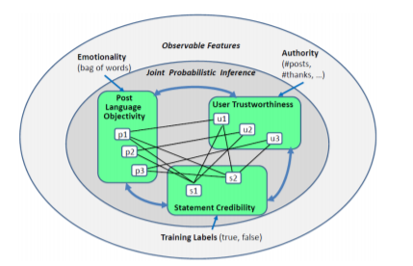
Related works on truth discovery
Original paper of the dataset from S. Mukherjee (2014) proposed a semi-supervised learning based on Conditional Random Field, with labels annotated based on similarity threshold. This suffers from the mentioned problems.

Slide 9
Related work on truth discovery
Fenglong Ma (2017) focused on discovering side effects of drugs instead of inferring truth for each thread. Candidate side-effects were extracted from posts.
Yaliang Li (2016) could only predict for a single instead of multiple side effects and did not take into account relationship between multiple posts of a same thread.
=> Little work has been done on supervised learning in truth discovery.
=> The annotation process of many works suffer from mentioned problems.
=> Proposed methods could not effectively learn from raw inputs of posts and predict for multiple side-effects

Slide 10
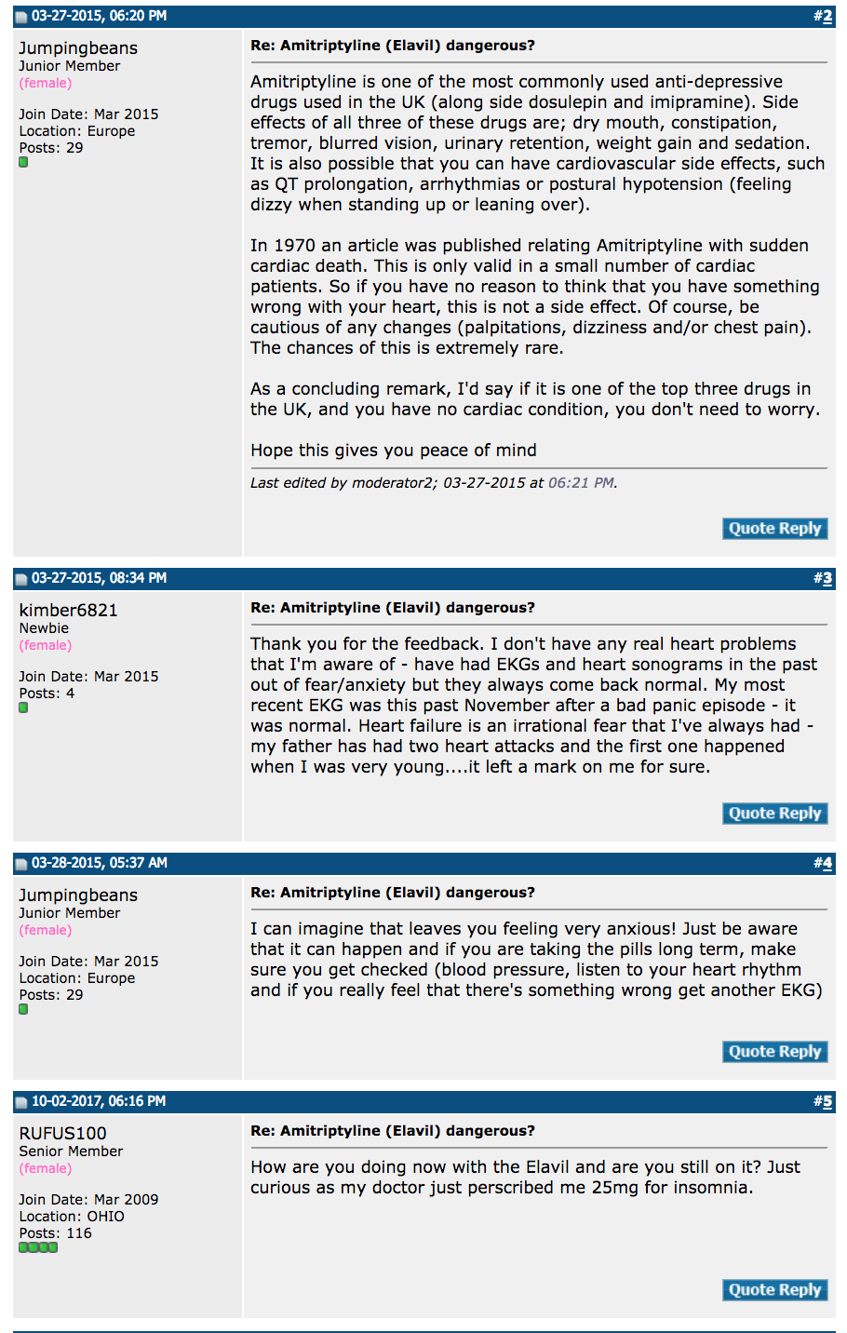
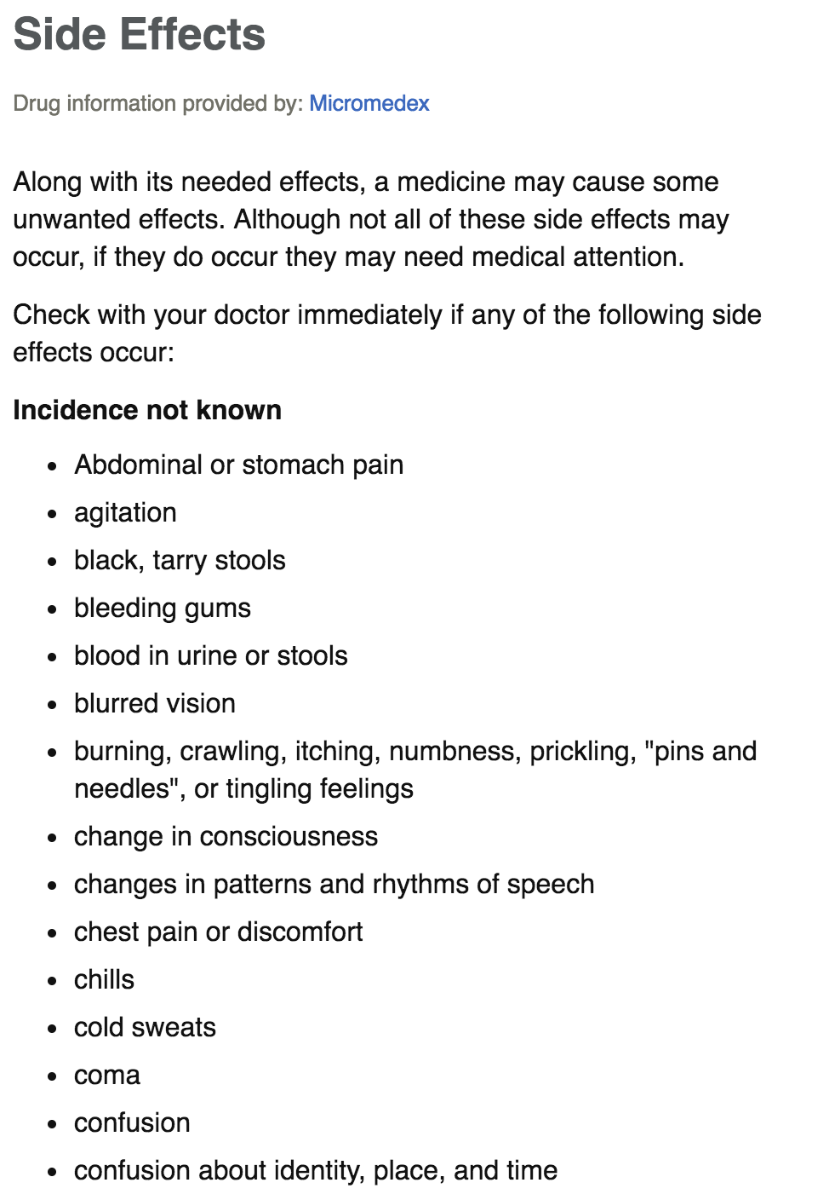

Slide 11
Dataset
Ground truth obtained from Mayo Clinic portal as free text
A document is label “credible” (positive) if the similar between it and the actual side-effect greater than a certain threshold
724,916 posts from 14101 users in 87,287 threads about 1329 drugs
UMLS used to extract biomedical concepts and terms
Pre-trained word2vec model from Google with embedding dimension = 300

Slide 12
A proposed method inspired by machine translation
Encoder

Slide 13
A proposed method inspired by machine translation
Encoder

Slide 14
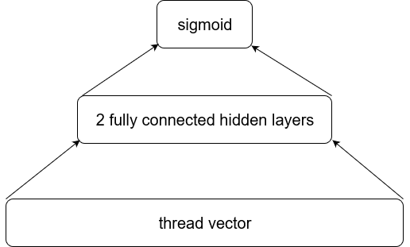
A proposed method inspired by machine translation
Decoder

Slide 15
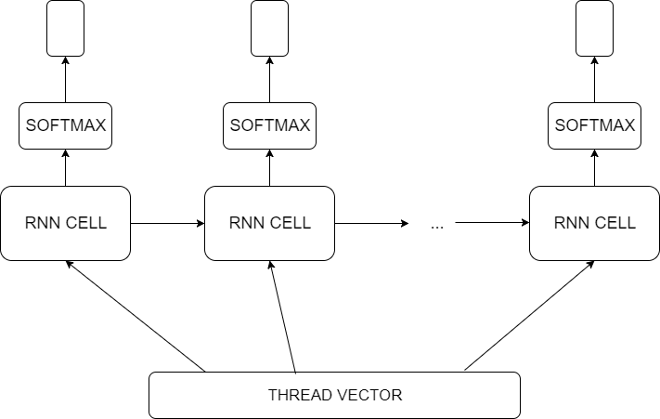
A proposed method inspired by machine translation
Decoder

Slide 16
A proposed method inspired by machine translation
Attention mechanism to focus on “symptom” words
Use BLEU as evaluation metrics

