Slide 1
UROP update Feb 23rd
Credibility analysis in health communities
Nguyen Van Hoang

Slide 2
Progress update
Pre-processing
Finalise model architecture
Implement proposed methodology
Record preliminary results

Slide 3
Pre-processing
Input:
Thread content: list of posts involved and corresponding users
Output:
List of side effects of the drug assigned to each thread
=> Can be considered as a multi-class multi-label classification

Slide 4
Pre-processing
Dataset
88606 threads
14996 users
813588 posts
61597 vocab
1869 drugs
1496 labels
Pre-trained word2vec with embedding size = 300

Slide 5
Pre-processing
N-gram phraser is used to extract side effects of drugs
Original | Phrased
loss appetite | loss_appetite
blurred vision | blurred_vision
lower back side pain | lower_back_side_pain

Slide 6
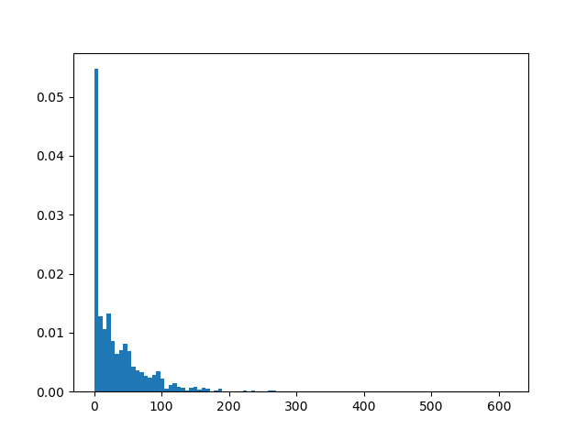
Pre-processing
Side effects distribution of drugs
There are upto 1500 labels, but each drug on has on average 50 side effects.
=> The target vectors are sparse

Slide 7
2) Model architecture
Encoder

Slide 8
2) Model architecture
Encoder

Slide 9
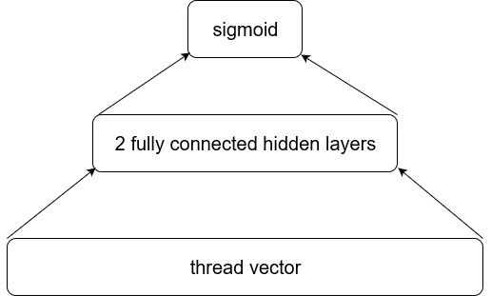
2) Model architecture
Decoder

Slide 10
3) Preliminary results
Without user expertise vector and user credibility
 | Proposed method
Accuracy | 0.9121
Precision | 0.0861
Recall | 0.7025
F1 | 0.1535

Slide 11
4) Incoming weeks plan
Exploring papers on multi-label multi-classification, especially on sparse labels
Finish implementation
Start writing final report

