Slide 1
UROP update Jan 18th
Credibility analysis in health communities
Nguyen Van Hoang

Slide 2
Recap - Credibility analysis
About my project
Explore online health communities such as healthboards, quora and analyse credibility of user posts
Implement baselines and propose methods to classify user posts as credible or not

Slide 3
Dataset
724,916 posts from 14101 users in 87,287 threads about 1329 drugs
UMLS used to extract biomedical concepts and terms
Pre-trained word2vec model from Google with embedding dimension = 300
Ground truth obtained from Mayo Clinic portal as free text
A document is label “credible” (positive) if the similar between it and the actual side-effect greater than a certain threshold

Slide 4
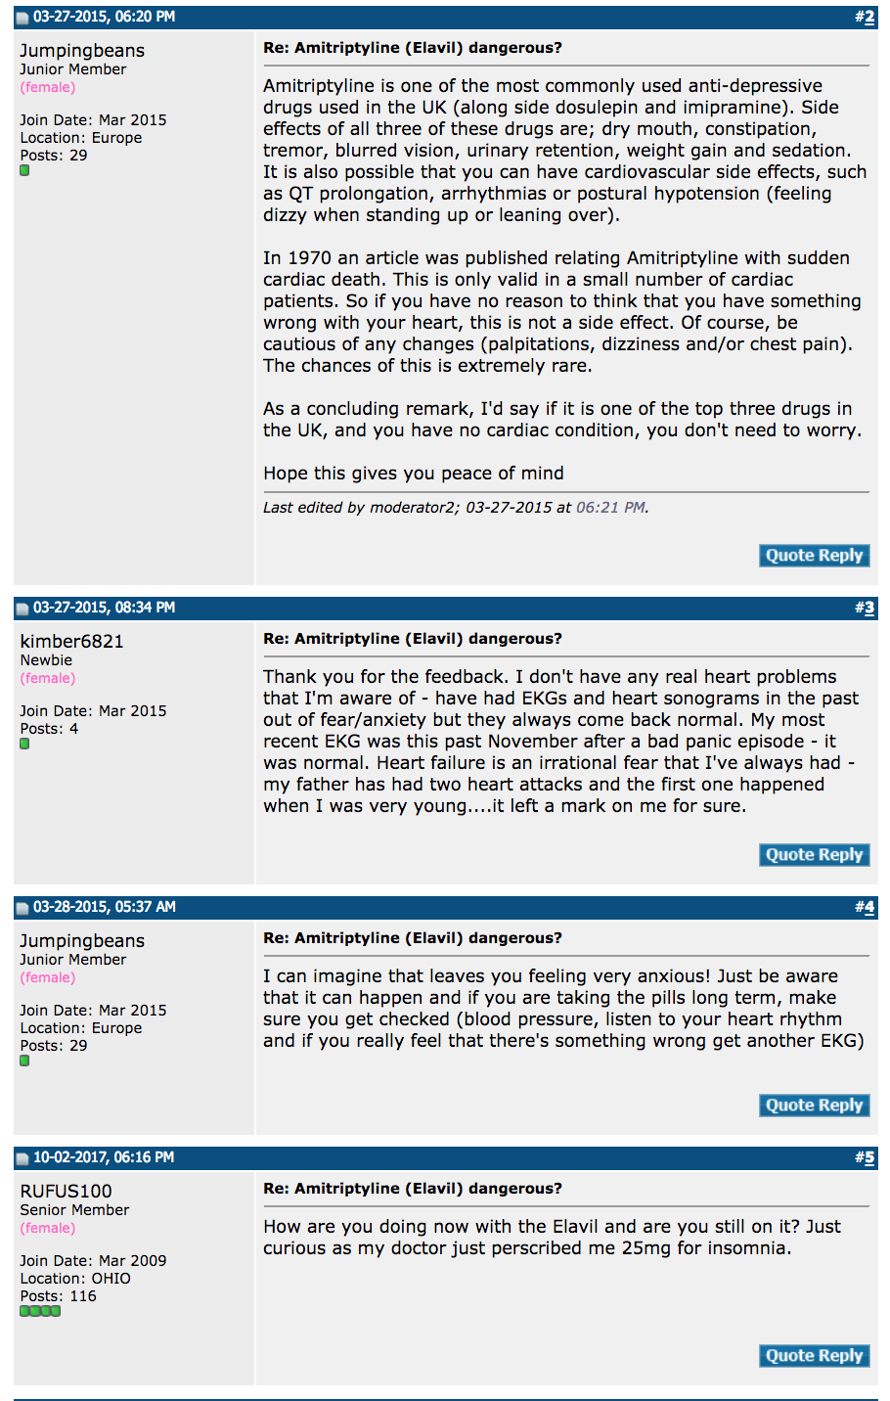
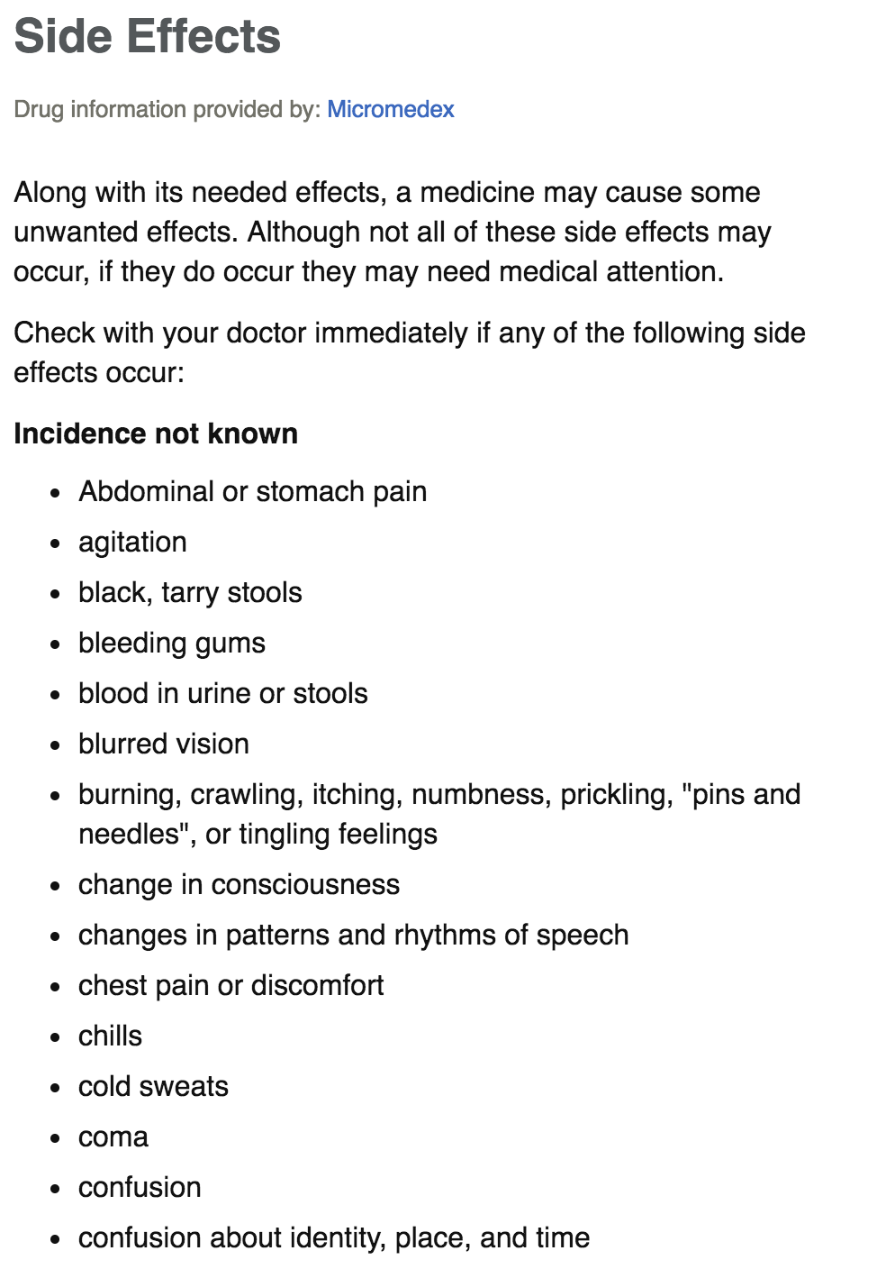

Slide 5
Updates
Re-propose methodology
Compute mathematics derivation
Include charts and graphs

Slide 6
Re-propose methodology
On ground-truth annotation
The dataset from original paper was not annotated by experts
There’s no feature that is directly correlated with a post credibility (such as the number of likes) to determine its label.
However, actual side effects of drug exist, and I wish to measure the similarity between them and the post in question to infer the correct label for training
2 questions:
What type of similarity to use?
How to determine the cut-off threshold?

Slide 7
Jaccard similarity
A sensible way
Defined as
However, it does not take into account semantics
E.g. heart and cardiac have great similarity

Slide 8
Word embedding with tf-idf weighted
The summation of words in a post and the corresponding side effects (truth), weighted by the word’s tf-idf.
Similarity is measured by cosine similarity between post and truth vectors
Takes into account semantics

Slide 9
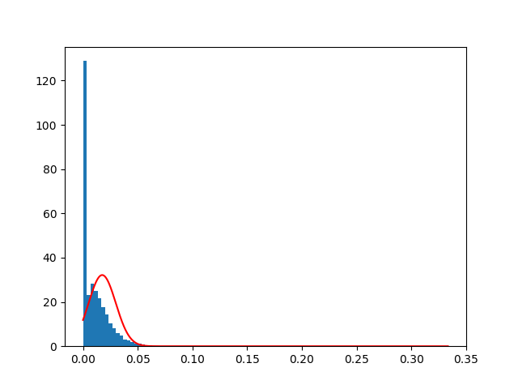
Jaccard distribution
I fit a random distribution to the data after omitting data points with 0 similarity
Mean: 0.01753
Standard deviation: 0.012

Slide 10
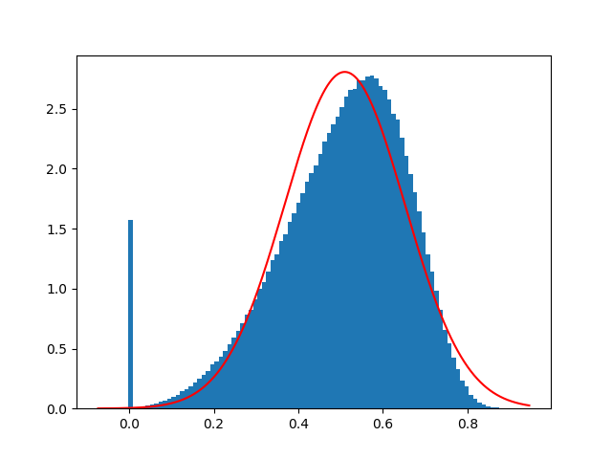
Word-embedding with tf-idf weighted distribution
I fit a random distribution to the data after omitting data points with less than 0.01 similarity
Mean: 0.50973
Standard deviation: 0.142
=> I decided to choose word-embedding with tf-idf, cut-off threshold = mean, to annotate my dataset

Slide 11
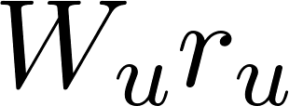
b) On architecture and loss function
For supervised learning and binary classification, I decided to adopt logistic loss with maximum likelihood estimation
where
Total signal
Where (dot product)
The signal is a linear combination of 3 components:
User feature signal
Similarity between post vector and thread vector
Similarity between user expertise vector and thread vector

Slide 12
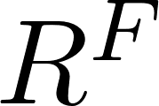
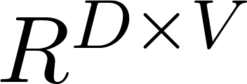
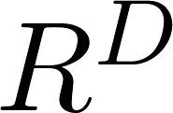
b) On architecture and loss function
Symbol | Description | Dimension
 | Number of vocabulary | Scalar
 | Word embedding dimension | Scalar
 | Number of user | Scalar
 | Number of user feature | Scalar
 | User feature weight vector
 | Document matrix of a post and a thread
 | Word weight vector
 | User embedding

Slide 13
b) On architecture and loss function
Document matrices are formed by
Where is the word embedding from our pre-trained model
Is the word frequency in document

Slide 14
2) Mathematics derivation
By maximizing log likelihood, we minimize the following loss function
Where

Slide 15
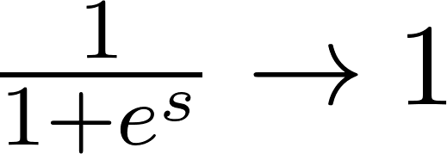
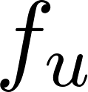
2) Mathematics derivation
Derivative w.r.t
With gradient descent based optimization
When there’s misclassification, is negative
is updated according to

Slide 16
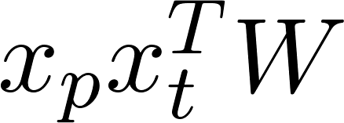
2) Mathematics derivation
Derivative w.r.t
With gradient descent based optimization
When there’s misclassification, is negative
is updated according to (approximate similarity between post vectors and the thread vectors and (approximate similarity between thread vectors and user expertise vector)

Slide 17
2) Mathematics derivation
Derivative w.r.t
With gradient descent based optimization
When there’s misclassification, is negative
is updated according to or the average of all thread vectors

Slide 18
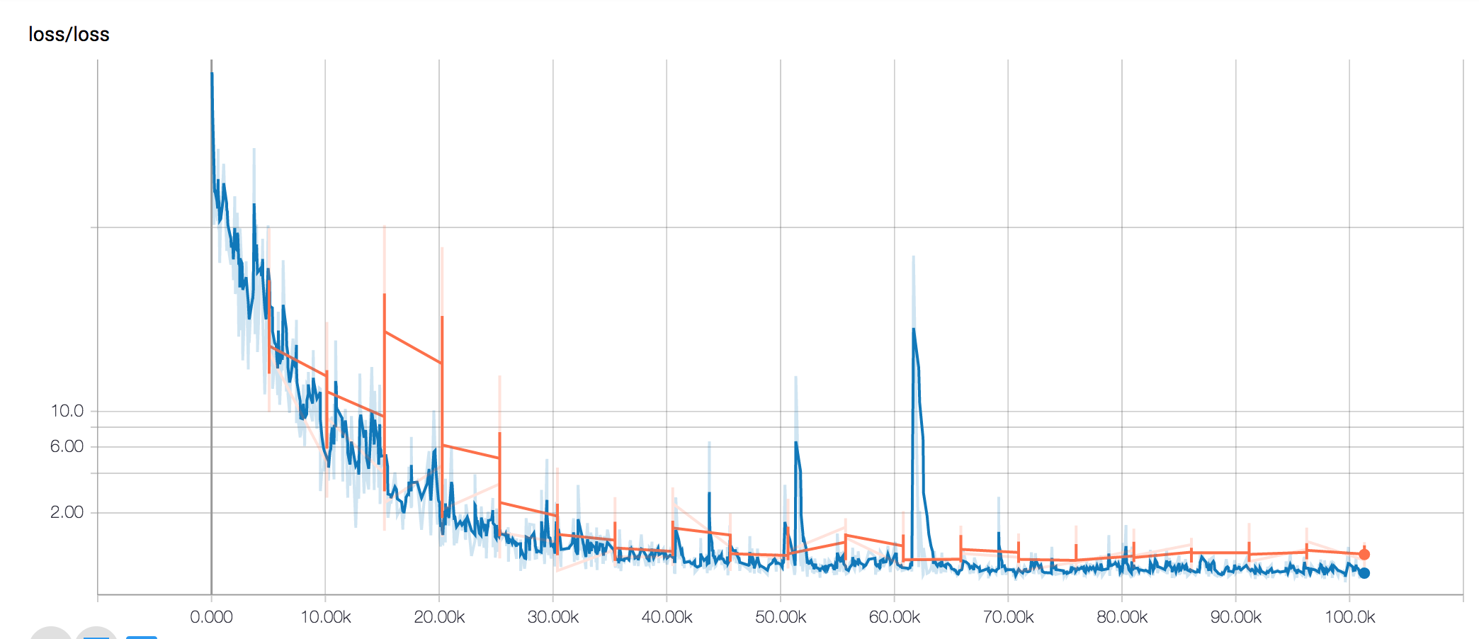
3) Chart and graph
Loss

Slide 19
3) Chart and graph
b) Tensorflow computation graph

Slide 20
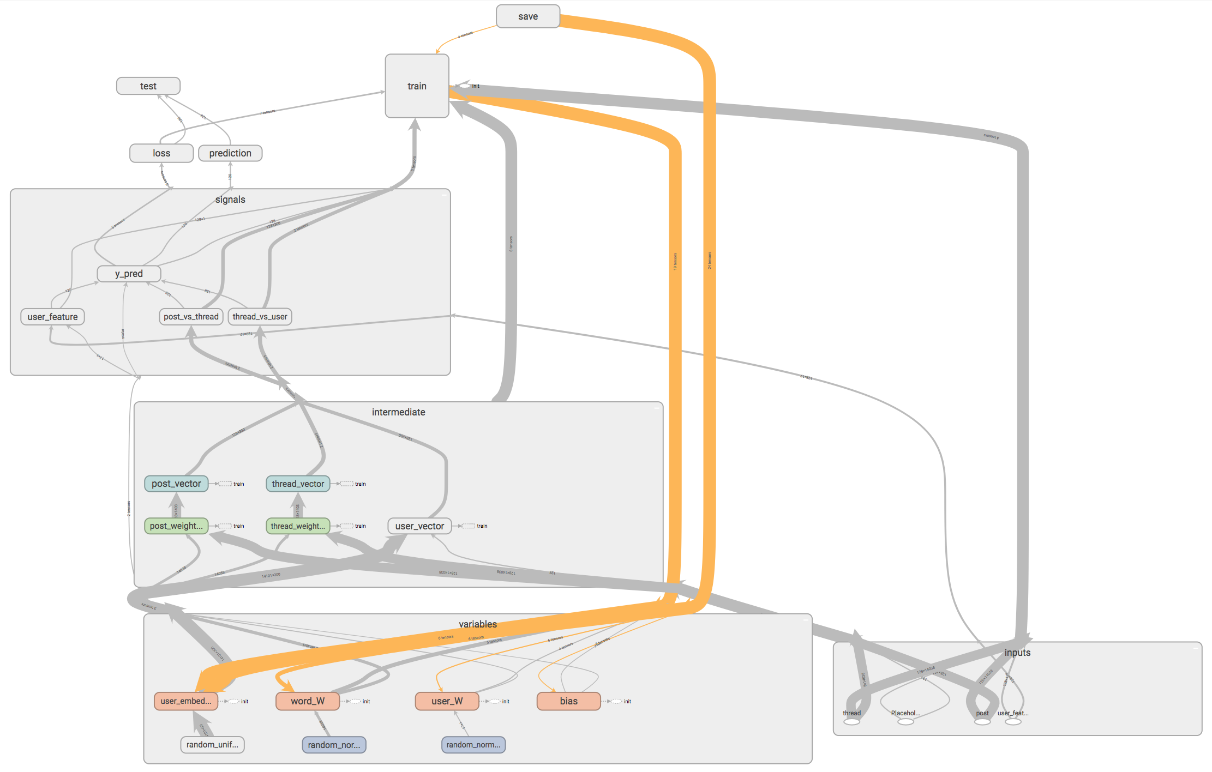
3) Chart and graph
b) Architecture

Slide 21
4) Results
 | Proposed method | MLP
Area under the curve | 0.8173
Accuracy | 75.08 | 78.08 | 0.5411 | 0.7109 | 0.6157
Recall | 74.59 | 66.42
Precision | 77.62 | 89.68
F1 score | 76.08 | 76.32

