Slide 1
UROP update March 9th
Credibility analysis in health communities
Nguyen Van Hoang

Slide 2
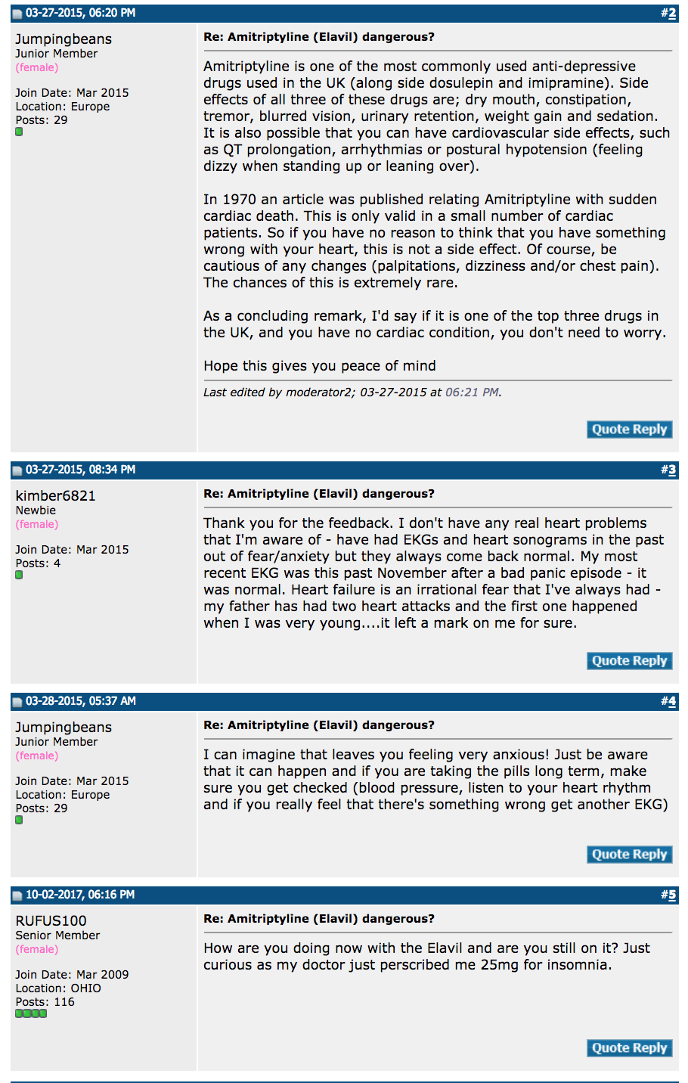
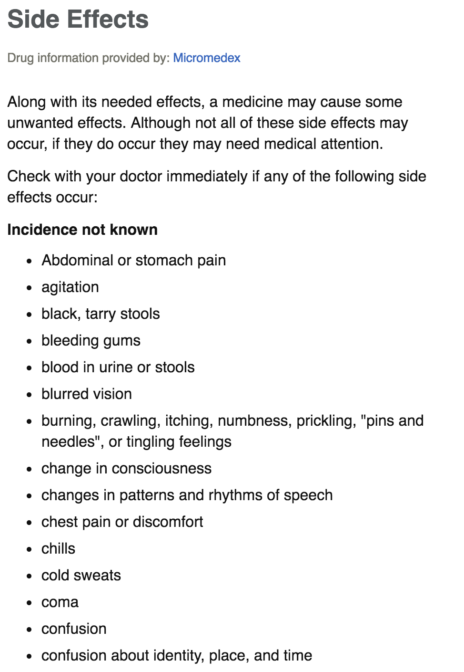

Slide 3
Pre-processing
Input:
Thread content: list of posts involved and corresponding users
Output:
List of side effects of the drug assigned to each thread
Learned parameters:
User credibility
User expertise
Can be considered as a multi-class multi-label classification

Slide 4
Pre-processing
Dataset
88606 threads
14996 users
813588 posts
61597 vocab
1869 drugs
1496 labels
Pre-trained word2vec with embedding size = 300

Slide 5
Pre-processing
N-gram phraser is used to extract side effects of drugs
Original | Phrased
loss appetite | loss_appetite
blurred vision | blurred_vision
lower back side pain | lower_back_side_pain

Slide 6
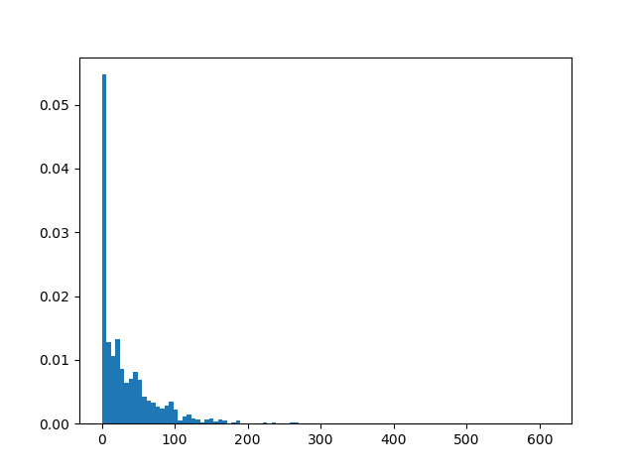
Pre-processing
Side effects distribution of drugs
There are upto 1500 labels, but each drug on has on average 50 side effects.
=> The target vectors are sparse

Slide 7
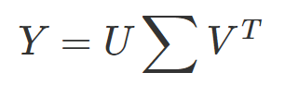
Pre-processing
Dimensionality reduction using Singular Vector Decomposition
Decompose K by N label matrix
Obtain projection matrix
Reconstruction matrix
Reduce K = 1496 to M = 100 and preserve 93% variance

Slide 8
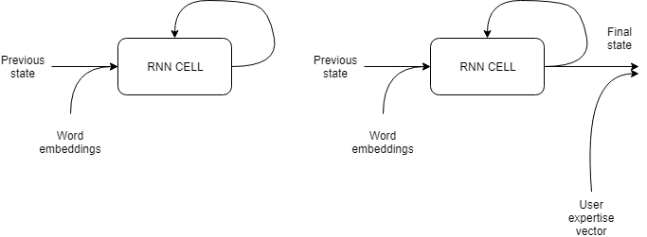
2) Model architecture
Encoder

Slide 9
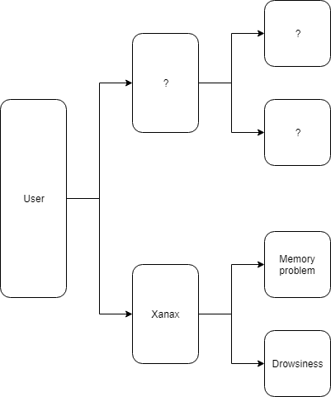
Intuition behind user expertise
User expertise can be modelled across different threads
Give us an idea of what category of drug a user is using
E.g. depression medication

Slide 10
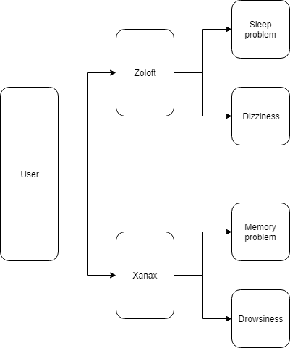
Intuition behind user expertise
User expertise can be modelled across different threads
Give us an idea of what category of drug a user is using
E.g. depression medication

Slide 11
2) Model architecture
Encoder

Slide 12
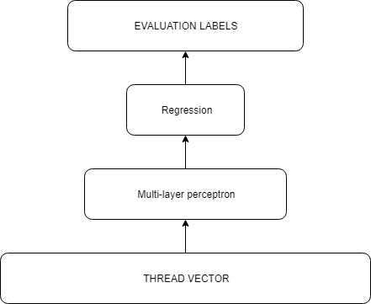
2) Model architecture
Decoder

Slide 13
3) Results
 | Without user expertise | With user expertise
Accuracy | 0.4481 | 0.5178
Precision | 0.1791 | 0.2124
Recall | 0.7995 | 0.8787
F1 | 0.2926 | 0.3420

Slide 14
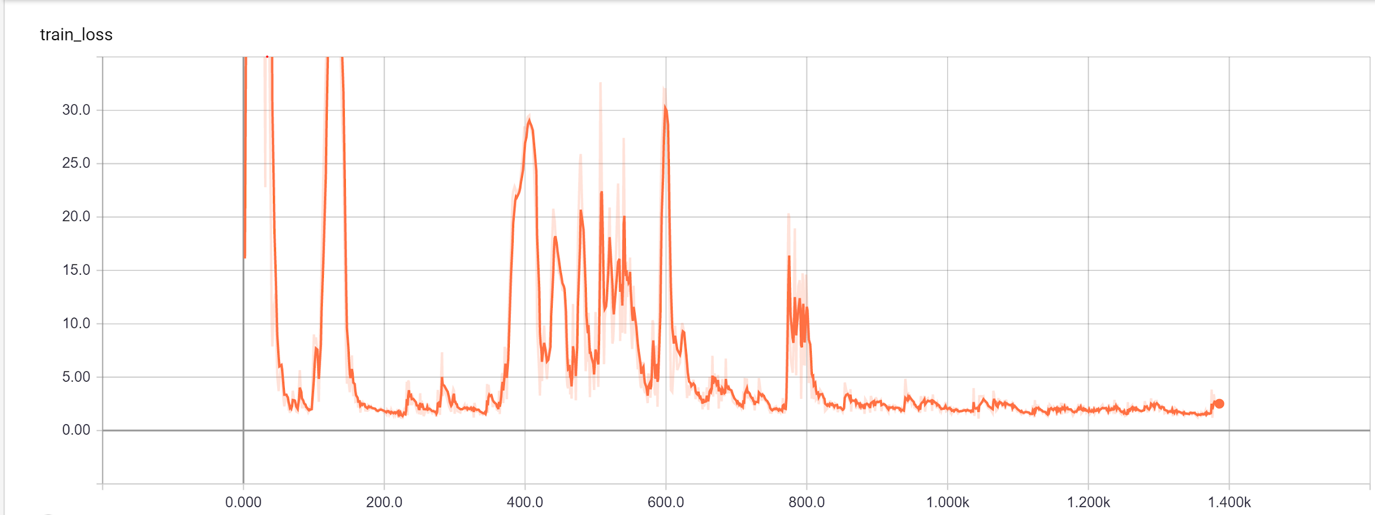
3) Results

